Slide 1
Flow Through Packed and Fluidized Beds
By
Amol Deshpande

Slide 2
Outline
Flow through beds of solids
Motion of particles through fluids
Fluidization

Slide 3
Flow through beds of solids
Objective → To study the behaviour of single phase fluid flow through a column of stationary solid particles
Resistance to the flow of fluid (leads to pressure drop) → function of total drag on solid boundaries
Calculation of this pressure drop (total drag)
Need to take tortuous channels through the bed into consideration

Slide 4
Flow through beds of solids – Important parameters
Surface to volume ratio
Sphericity
Porosity (void fraction)
Equivalent channel diameter
Superficial velocity
Average velocity

Slide 5
Calculation of pressure drop
Pressure drop depend on average velocity and channel diameter
Average velocity and channel diameter can be expressed in terms of measurable parameters (superficial velocity, diameter of particle, porosity)
Low Re
Hagen-Poiseuille equation

Slide 6
Calculation of pressure drop
Kozeny-Carman equation
Applicable for very low Re (Re_{p} < 1.0)
Darcy’s law
Used to describe the flow of liquids through porous media
Burke-Plummer equation
Applicable for high Re (Re_{p} > 1000)
Ergun equation
Effect of void fraction on pressure drop

Slide 7
Mixture of particles in the bed
Ergun equation can be used to determine the pressure drop
Particle diameter will be replaced by surface mean diameter of the mixture.

Slide 8
Motion of particles through fluids
Mechanics of particle motion
Balance of forces
External force
Buoyant force
Drag force
One dimensional motion of particle through fluid
Generalized equation
Motion from gravitational force
Motion in a centrifugal field

Slide 9
Motion of particles through fluids
Terminal velocity
Maximum attainable velocity by a particle moving through the fluid
For gravitational settling
In motion from centrifugal force
Drag coefficient (Fig. 7.7)
Curve applicable under certain restrictions – like solid particle, particle is far from other particles and wall, moving with terminal velocity

Slide 10
Motion of spherical particles
Generalized expression for terminal velocity
Low Re (Re <1)
Drag coefficient
Drag force
Terminal velocity → Stoke’s law
For high Re (1000 < Re < 200,000)
Drag coefficient
Drag force
Terminal velocity → Newton’s law

Slide 11
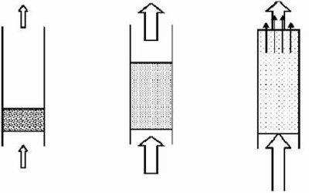
Fluidization
It is corresponding to the condition of fully suspended particles (as suspension behaves as dense fluid)

Slide 12
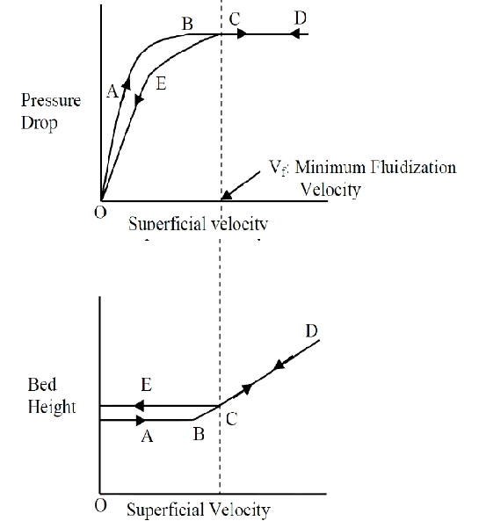
Fluidization
Important design
parameters
Minimum fluidization
velocity
Bed expansion of
fluidization
Pressure variation in
bed

Slide 13
Minimum fluidization velocity
Can be obtained by setting pressure drop across the bed equal to the weight of the bed per unit area of cross section
Expression for minimum fluidization velocity
Ergun equation → quadratic equation
Kozeny-Carman (Low Re)
V_{OM} is proportional to D_{p}²
Burke-Plummer equation (High Re)
V_{OM} is proportional to D_{p}^{0.5}

Slide 14
Terminal velocity and Minimum fluidization velocity
For low Re (small particles) – Stoke’s law regime
Both vary with D_{p}² and density difference (particle and fluid) and viscosity
Their ratio depends only on void fraction at minimum fluidization velocity and its high (Approximately 50 for spherical particles)
For high Re (coarse particles) – Newton’s law regime
Low ratio

Slide 15
Types of fluidization
Particulate fluidization
Particles move farther apart and their motion becomes more vigorous as velocity is increased but average density of the bed at a given velocity is same in all sections
E.g. Sand particles in water
Bubbling fluidization/Aggregative fluidization
Gases pass through the solid as bubbles or voids
E.g. solids fluidized with air

Slide 16
Application of fluidization
Fluid catalytic cracking
Mainly in regenerating the catalyst
Catalytic processes
Synthesis of acrylonitrile
Solid gas reactions
Fluidized bed combustion of coal

Slide 17
Advantages / Disadvantages of fluidization
Advantages
Solid is vigorously agitated by the fluid and there is practically no temperature gradients
Provides high heat transfer rates to the walls of the bed
Easy to transport solids
Disadvantages
Uneven contacting of gas and solids
Erosion of vessel internal parts
Attrition of solid particles

